Slide 1
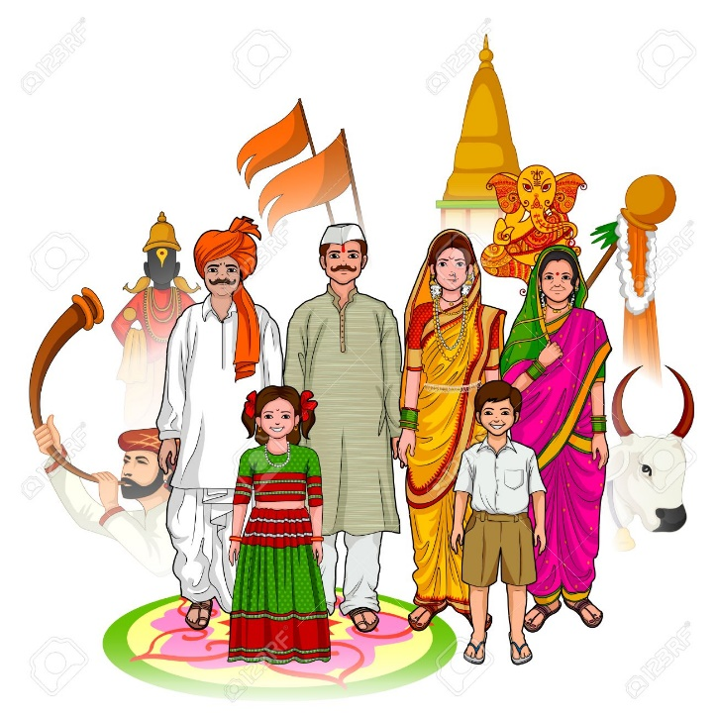
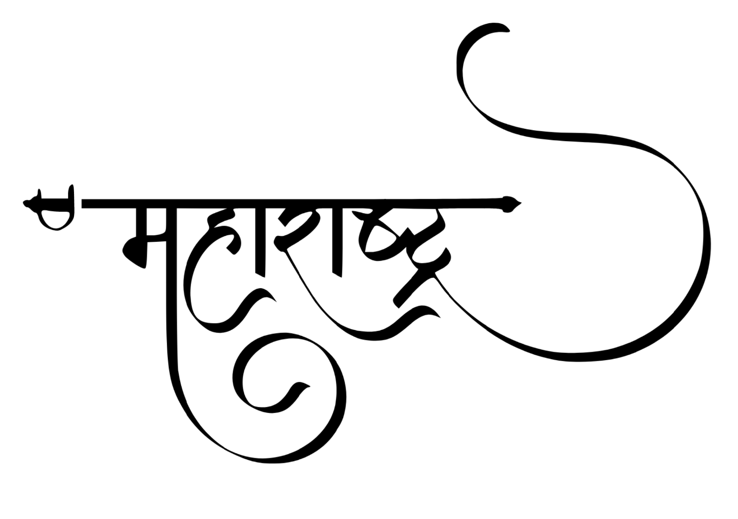

Slide 2
जय जय
महाराष्ट्र माझा
गर्जा महाराष्ट्र
माझा

Slide 3
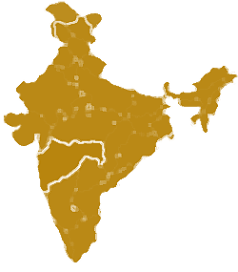
Information
Location : 18.97°N 72.820°E
Formaton : 1 May 1960
Capitals: Mumbai, Nagpur(Winter)
Districts: 36
Body : Government of Maharashtra
Governor: Bhagat Singh Koshyari
Chief Minister: Udhhav Thackeray
Deputy Chief Minister : Ajit Pawar
Area : 307,713 Square Km
Area rank : 3rd
Population: 112,374,333
महाराष्ट्र

Slide 4
Geography Of Maharashtra
कोकण
देश
खान्देश
विदर्भ
मराठ्वाडा
Maharashtra occupies the western and central part of the country and has a long coastline stretching 720 kilometres along the Arebian Sea
One of the more prominent physical features of Maharashtra is the Deccan plateau, which is separated from the Konkan coastline by 'Ghats‘.
The Western Ghats (or the Sahyadri Mountain range) provide a physical backbone to the state on the west, while the Satpura hills along the north and Bhamragad-Chiroli-Gaikhuri ranges on the east serve as its natural borders. The state is surrounded by Gujarat to the north west, Madhya Pradesh to the north, Chhattisgarh to the east, Telangana to the south east, Karnataka to the south and Goa to the south west.
Maharashtra is the third largest state by area in India. Maharashtra has 36 districts, 355 talukas, 535 cities, 66,663 villages, 6 administrative divisions.
Kalsubai, a peak in the Sahyadris, near Nashik city is the highest elevated point in Maharashtra.

Slide 5
Climate
Maharashtra has a tropical climate, with three distinct seasons: Summer (March–May), Monsoon (June–September), and Winter (October–February)
Summers (March, April and May) are extremely hot, the temperature rises from 22 °C to as high as 43 °C during the summer.
July is the wettest month in Maharashtra, while August also gets substantial rain. The rainy season starts its retreat with the coming of September to the state. Rainfall in Maharashtra differs from region to region.
In winter, a cool dry spell occurs, with clear skies, gentle air breeze, and pleasant weather prevails from October to February. But the eastern part of Maharashtra sometimes receives some rainfall. Temperature rise from 12 °C to 34 °C during this season.

Slide 6
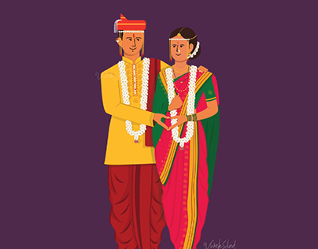
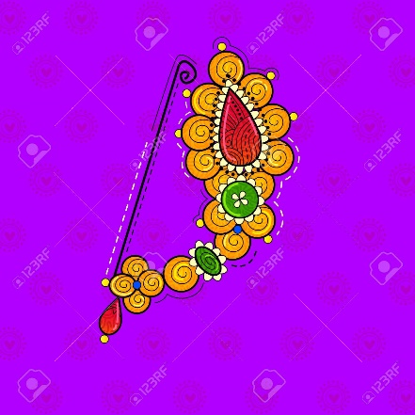
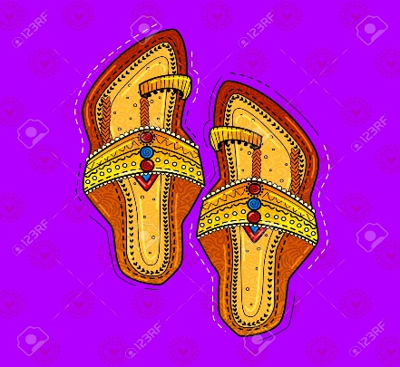
Clothing and Jewellery
Traditional clothes for Maharashtrian males include the dhoti, also known as Dhotar, and pheta, while a choli and nine-yard saree locally known as Nauwari Saadi or Lugda is for women. Traditional clothing is famous in rural areas while traditional people from cities also wear these clothing. These clothes are worn by Maharashtrians while performing various festivals and in weeding function also. A Kolhapuri Chappal is famous for both men and women.
As Maharashtra is the land of Marathas and Peshwas, women wear traditional jewelleries derived from these two dynasties. Another very much popular jewellery for the Marathi women is Kolhapuri saaj, a special type of necklace. It is designed in other parts of Maharashtra as well, but Kolhapuri saaj is the most famous one. Different types of bangles like Patlya, Bangdya and Tode are the typical jewellery on the hands of women in Maharashtra. Maharashtrians fond of pearls are vivid in their Chinchpeti, Tanmani and Nath. The Bajuband is also a favourite. Earrings with flower-shaped are a popular as well.

Slide 7
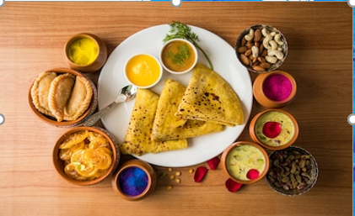
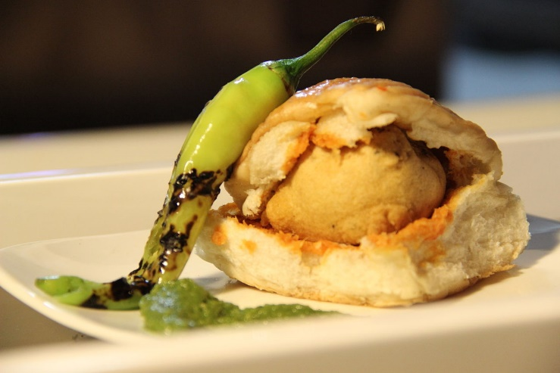
Food
A typical simple Maharashtrian meal with pithal, bhakari, raw onion and pickle. In the Konkan coastal area, boiled rice and rice bhakri, nachni bhakri is the staple, with a combination of the vegetable and non-vegetable dishes described in the lunch and dinner menu.
On special occasion or on occasion of festival Maharashtrian families make puranpoli, katachi amti and aloo wadi.
Typical breakfast items include missal, pohe, upma, sheera, sabudana khichadi and thaleepith.

Slide 8
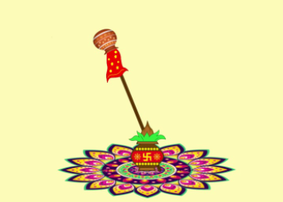
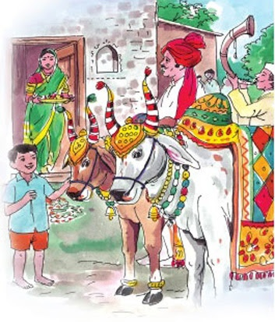
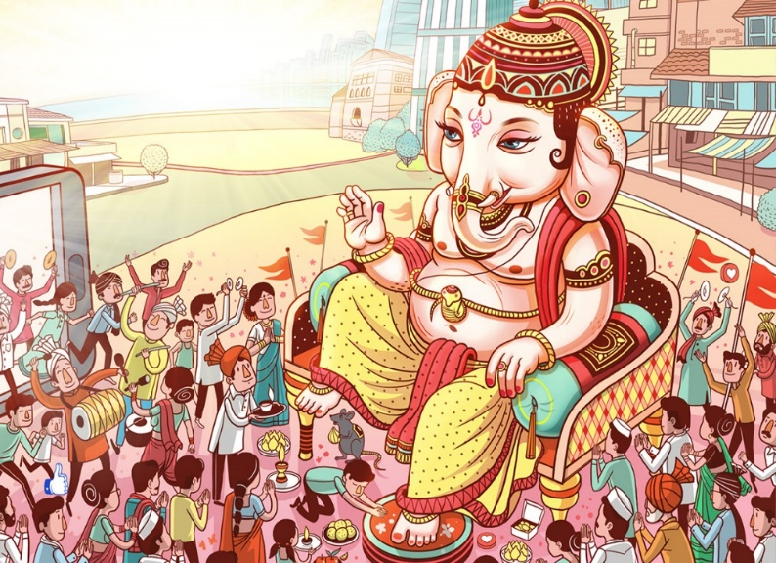
Festivals
As Maharashtra is a big state, it is home to many religions. The state also nurtures different traditions with diverse communities. Maharashtrians are fun loving people, so that might be another reason why the state has lots of different festivals.
Apart from the main festivals of Holi, Deewali and other festivals, which are celebrated, all over India, there are other festivals, which are celebrated locally and regionally in Maharashtra. Songs, dance and mouth watering cuisines accompany almost every festivals.
Ganesh Chaturthi and Gudipadwa is the most important festival in Maharashtra. Nag Panchami, Wat Pournima, Shivaji Maharaj Jayanti and Palkhi Festival are some of the important festivals of Maharashtra.
Ganeshshtra attained statehood on 1st May 1960. So, the day is organized as Maharashtra Day in Maharashtra. The state government organizes the main function in Mumbai.

Slide 9
धन्यवाद !!

